Slide 1
Practical Implementation of AWS Services
Name-C.S.S.SWETHA
Roll Number - 20A31A4205

Slide 2
LAB 1 - EC2

Slide 3
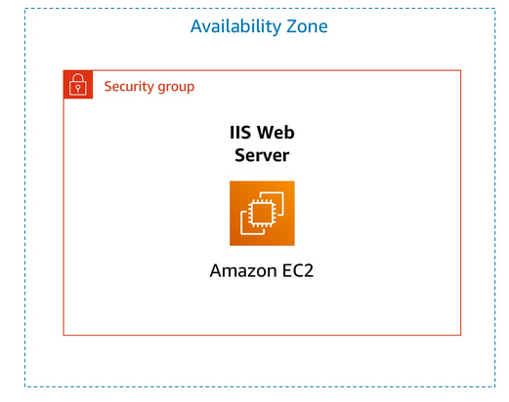
LAB 1 - Introduction to Amazon EC2
Amazon Elastic Compute Cloud (Amazon EC2) is a web service that provides resizable compute capacity in the cloud. It is designed to make web-scale cloud computing easier for developers.
Setting up an EC2 Instance-
This lab provides us with a basic overview of launching, resizing, managing, and monitoring an Amazon EC2 instance.
We do the following in this lab
Launch a web server with termination protection enabled
Monitor Your EC2 instance
Modify the security group that your web server is using to allow HTTP access
Resize your Amazon EC2 instance to scale
Explore EC2 limits
Test termination protection
Terminate your EC2 instance

Slide 4
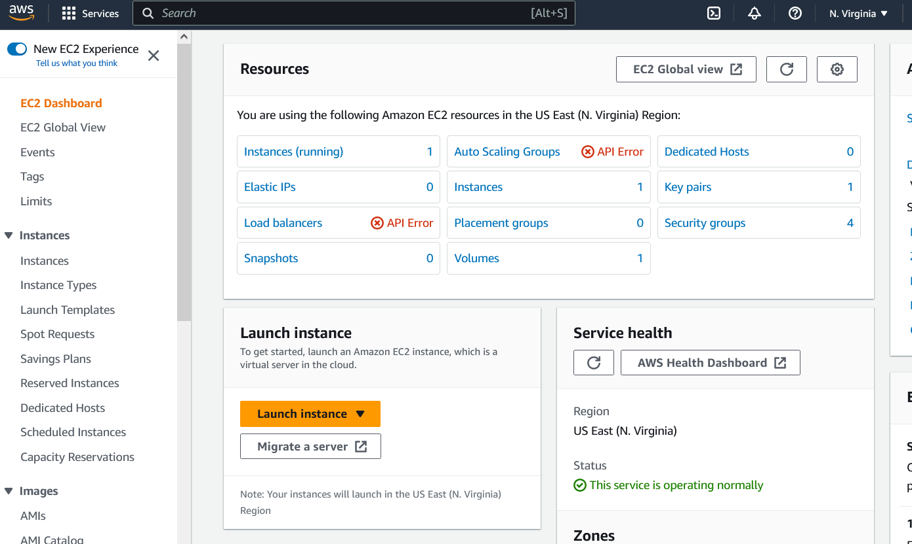
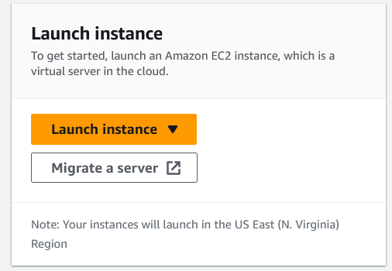
Task 1: Launch Your Amazon EC2 Instance
In the AWS Management Console choose Services, choose Compute and then choose EC2. Note: Verify that your EC2 console is currently managing resources in the N. Virginia (us-east-1) region. And Verify that you are the same region by looking at the drop down menu at the top of the screen, to the left of your username. If it does not already indicate N. Virginia, choose the N. Virginia region from the region menu before proceeding to the next step.
Choose the Launch instance menu and select Launch instance.

Slide 5
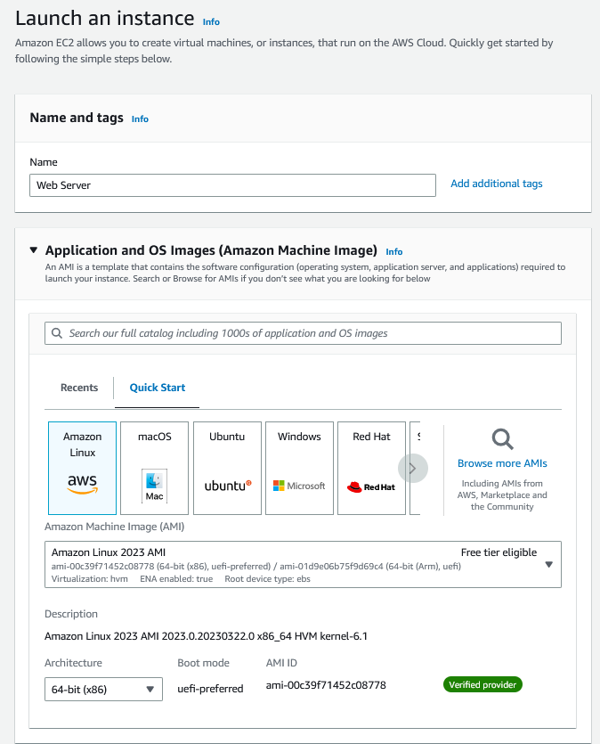
Step 1: Name and tags
Give the instance the name Web Server.
The Name you give this instance will be stored as a tag.
Each tag consists of a Key and a Value, both of which
you define. You can define multiple tags to associate with the
instance if you want to.
In this case, the tag that will be created will consist of a key
called Name with a value of Web Server
Step 2: Application and OS Images (Amazon Machine Image)
In the list of available Quick Start AMIs, keep the default
Amazon Linux AMI selected. Also keep the default Amazon Linux 2023 AMI selected.
An Amazon Machine Image (AMI) provides the information
required to launch an instance, which is a virtual server in the cloud.

Slide 6
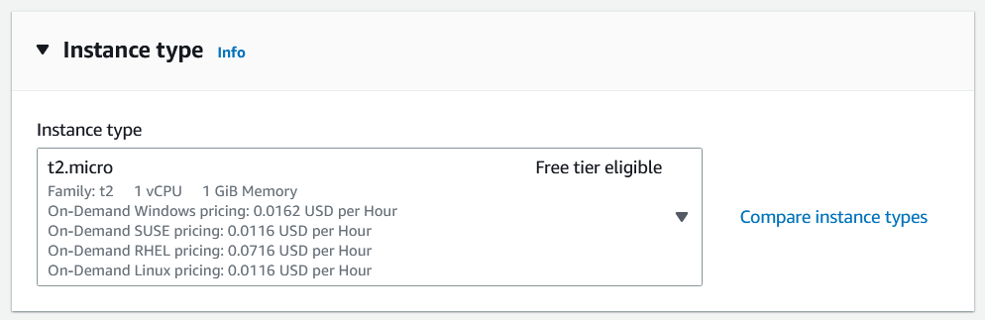
Step 3: Instance type
In the Instance type panel, keep the default t2.micro selected.
Amazon EC2 provides a wide selection of instance types optimized to fit different use cases. Instance types comprise varying combinations of CPU, memory, storage, and networking capacity and give you the flexibility to choose the appropriate mix of resources for your applications. Each instance type includes one or more instance sizes, allowing you to scale your resources to the requirements of your target workload.
The t2.micro instance type has 1 virtual CPU and 1 GiB of memory.

Slide 7
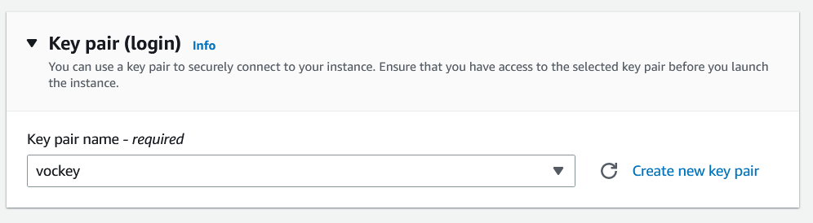
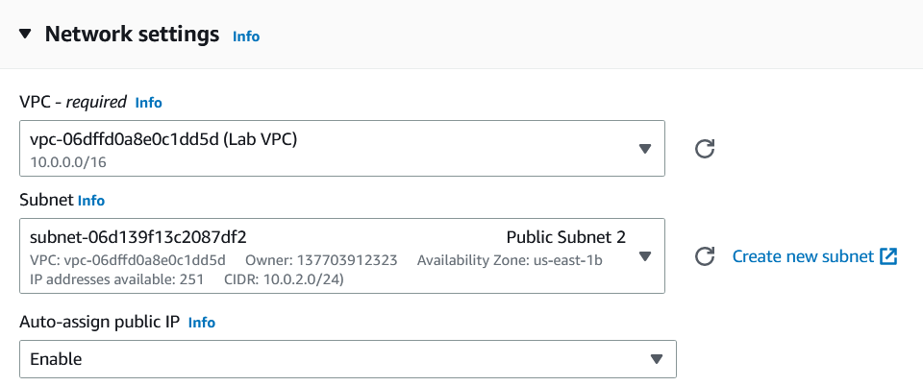
Step 4: Key pair (login)
For Key pair name - required, choose vockey. Amazon EC2 uses public–key cryptography to encrypt and
decrypt login information.
Step 5: Network settings
Next to Network settings, choose Edit.
For VPC, select Lab VPC. The Lab VPC was created using an AWS CloudFormation template during the setup process of your lab. This VPC includes two public subnets in two different Availability Zones.
Keep the default subnet. This is the subnet in which the instance will run. Notice also that by default, the instance will be assigned a public IP address.

Slide 8
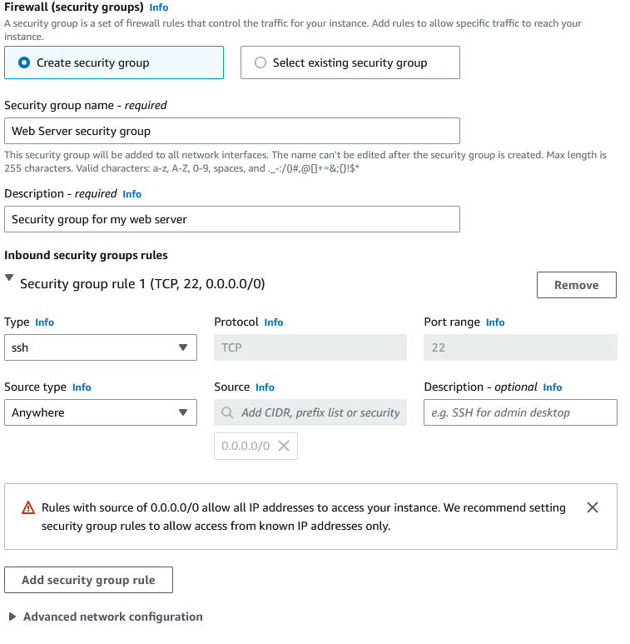
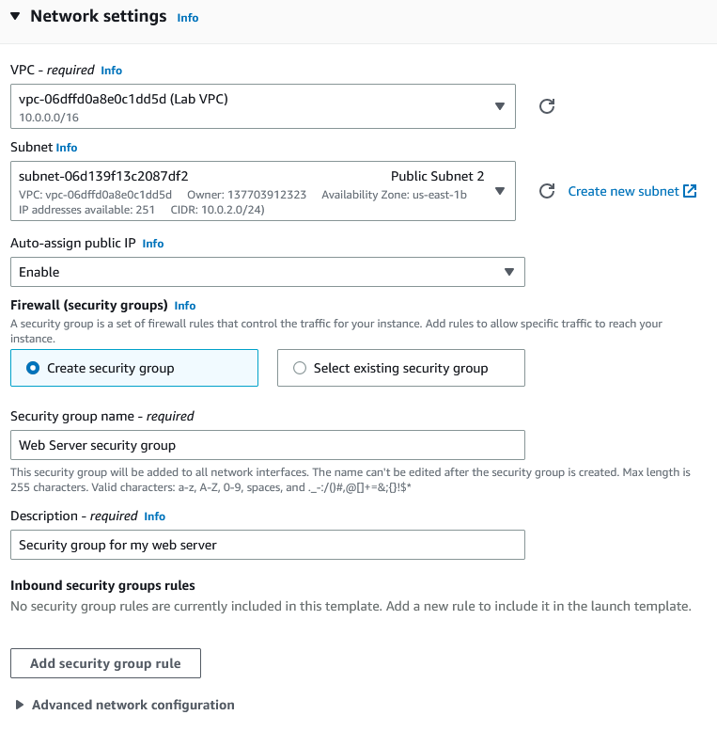
Under Firewall (security groups), choose Create security group and configure:
Security group name: Web Server security group
Description: Security group for my web server A security group acts as a virtual firewall that controls the
traffic for one or more instances.
Under Inbound security group rules, notice that one rule
exists. Remove this rule.

Slide 9
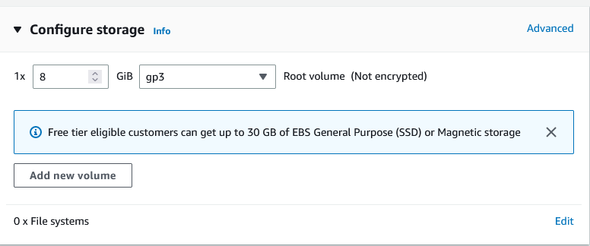
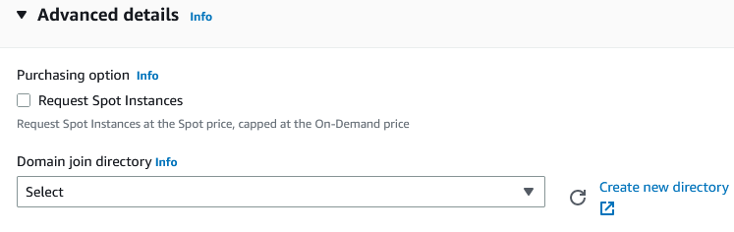
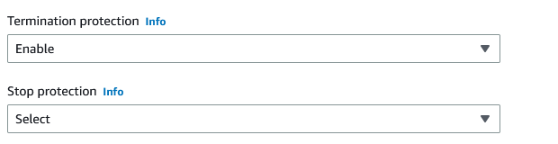
Step 6: Configure storage
In the Configure storage section, keep the default settings. Amazon EC2 stores data on a network-attached virtual disk called
Elastic Block Store. You will launch the Amazon EC2 instance using a default 8 GiB disk
volume. This will be your root volume (also known as a 'boot' volume).
Step 7: Advanced details
Expand Advanced details. For Termination protection, select Enable. When an Amazon EC2 instance is no longer required, it can be
terminated, which means that the instance is deleted and its resources
are released.

Slide 10
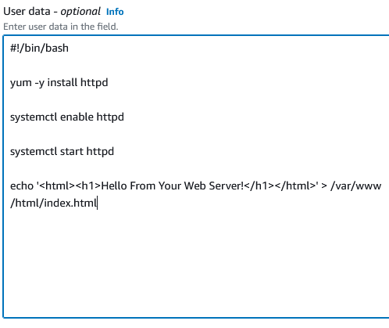
Scroll to the bottom of the page and then copy and paste the code
shown below into the User data box:
#!/bin/bash
yum -y install httpd
systemctl enable httpd
systemctl start httpd
echo '<html><h1>Hello From Your Web Server!</h1></html>' > /var/www/html/index.html
When you launch an instance, you can pass user data to the instance that can be used
to perform automated installation and configuration tasks after the instance starts. Your instance is running Amazon Linux 2. The shell script you have specified
will run as the root guest OS user when the instance starts.
The script will:
Install an Apache web server (httpd)
Configure the web server to automatically start on boot
Run the Web server once it has finished installing
Create a simple web page

Slide 11
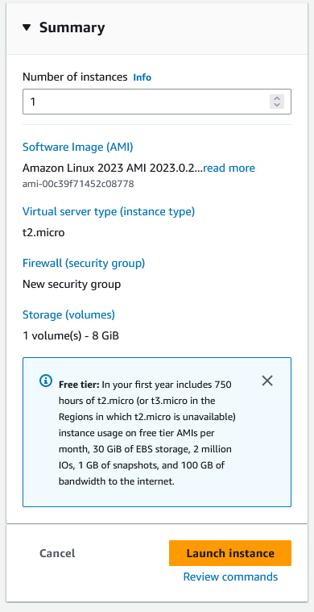
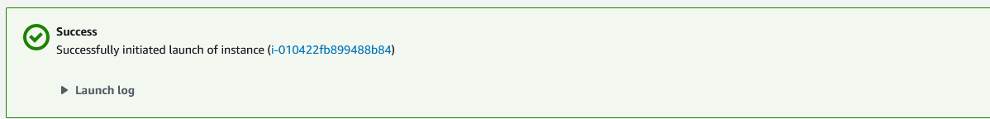
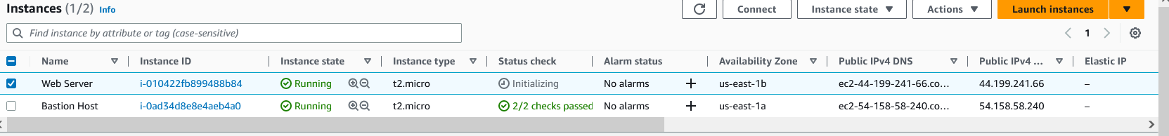
Step 8: Launch the instance
At the bottom of the Summary panel on the right side of the screen choose Launch instance You will see a Success message.
Choose View all instances
In the Instances list, select Web Server.
Review the information displayed in the Details tab.
It includes information about the instance type,
security settings and network settings. The instance is assigned a Public IPv4 DNS that you
can use to contact the instance from the Internet. At first, the instance will appear in a Pending state, which means
it is being launched. It will then change to Initializing, and finally to Running..

Slide 12
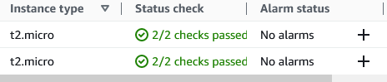
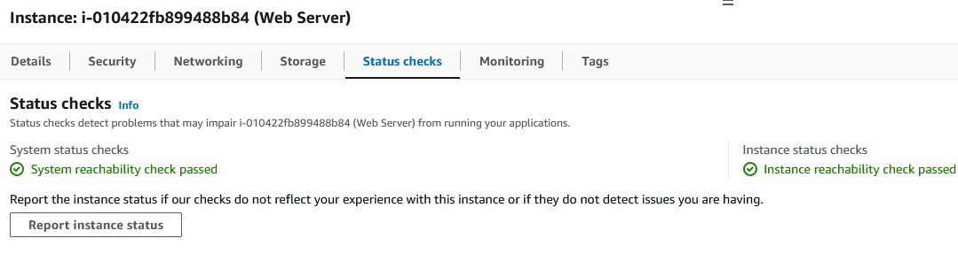
Wait for your instance to display the following:
Instance State: Running
Status Checks: 2/2 checks passed
Congratulations! We have successfully launched your first Amazon EC2 instance.
Task 2: Monitor Your Instance
Monitoring is an important part of maintaining the reliability, availability, and performance of your Amazon Elastic Compute Cloud (Amazon EC2) instances and your AWS solutions.
Choose the Status checks tab. With instance status monitoring, you can quickly determine whether Amazon EC2 has detected any problems that might prevent your instances from running applications. Amazon EC2 performs automated checks on every running EC2 instance to identify hardware and software issues. Notice that both the System reachability and Instance reachability checks have passed.

Slide 13
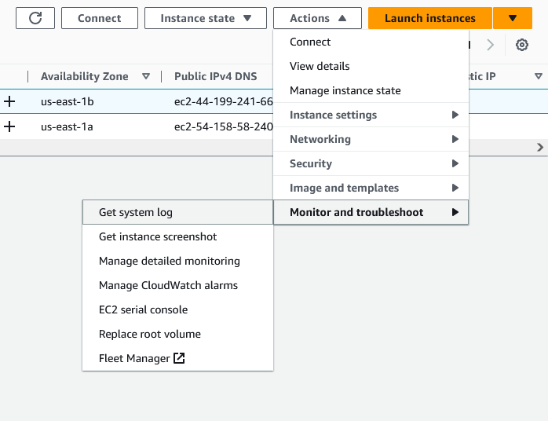
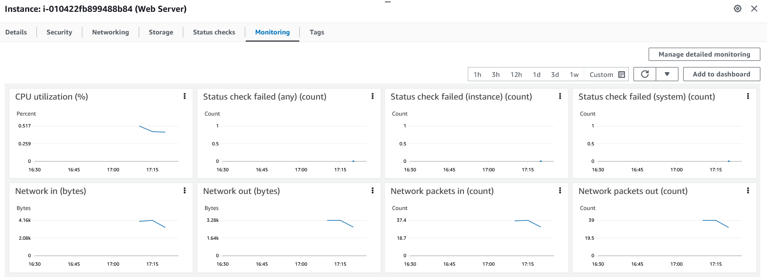
Choose the Monitoring tab. This tab displays Amazon CloudWatch metrics for your instance. Currently, there are not many metrics to display because the instance was recently launched. You can choose the three dots icon in any graph and select Enlarge to see an expanded view of the chosen metric. Amazon EC2 sends metrics to Amazon CloudWatch for your EC2 instances. Basic (five-minute) monitoring is enabled by default. You can also enable detailed (one-minute) monitoring.
In the Actions menu towards the top of the console, select Monitor and troubleshoot Get system log. The System Log displays the console output of the instance, which is a valuable tool for problem diagnosis. It is especially useful for troubleshooting kernel problems and service configuration issues that could cause an instance to terminate or become unreachable before its SSH daemon can be started. If you do not see a system log, wait a few minutes and then try again.

Slide 14
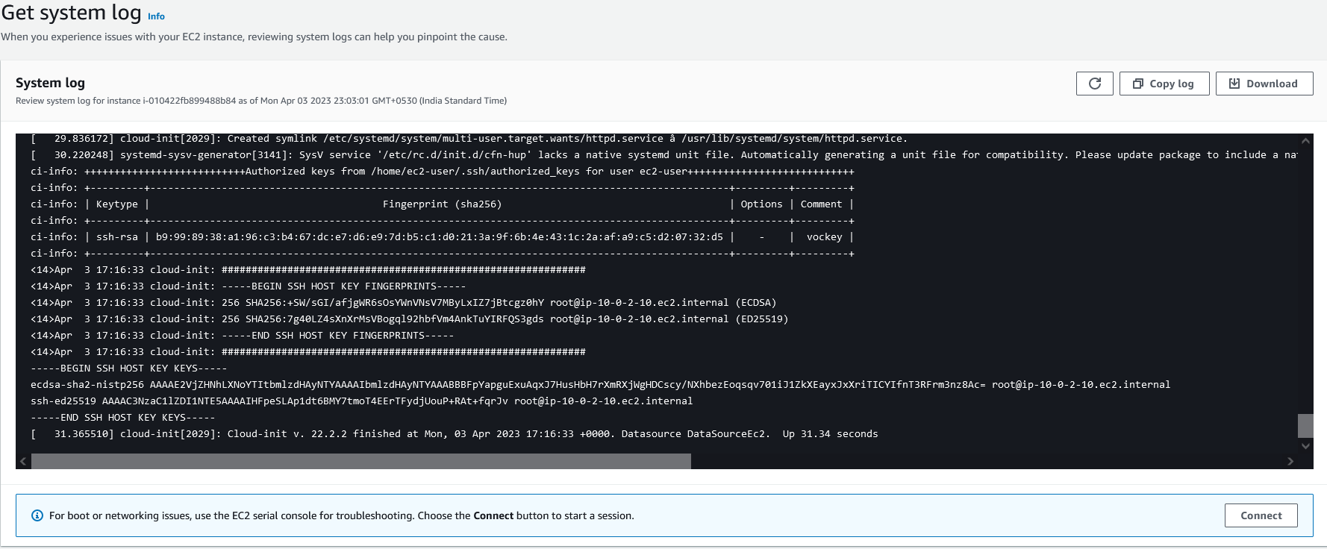
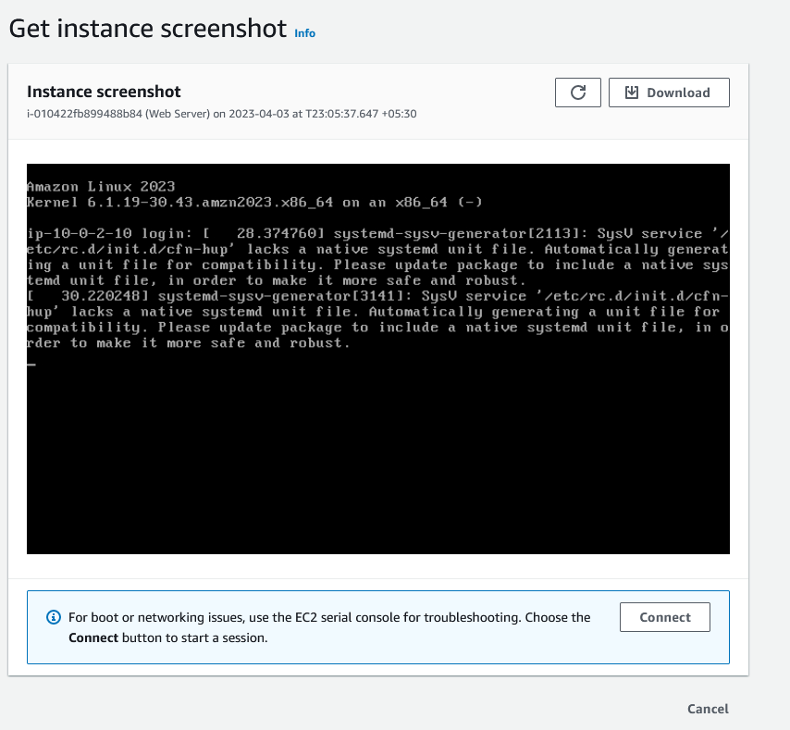
Scroll through the output and note that the HTTP package was installed from the user data that you added when you created the instance.
Choose Cancel.
Ensure Web Server is still selected. Then, in the Actions menu, select Monitor and
troubleshoot Get instance screenshot. This shows you what your Amazon EC2 instance console would look like
if a screen were attached to it.
If you are unable to reach your instance via SSH or RDP, you can capture a screenshot
of your instance and view it as an image. This provides visibility as to the status of the
instance, and allows for quicker troubleshooting.
Choose Cancel. Congratulations! We have explored several ways to monitor your instance.

Slide 15
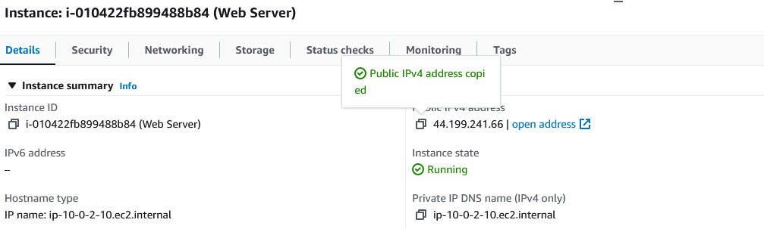
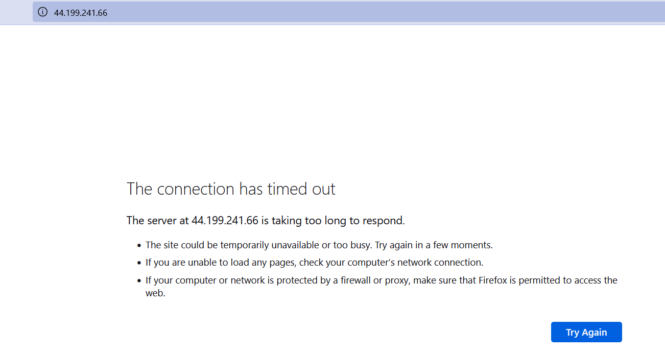
Task 3: Update Your Security Group and Access the Web Server
When you launched the EC2 instance, we provided a script that installed a web server and created a simple web page. In this task, we will access content from the web server.
Ensure Web Server is still selected. Choose the Details tab. Copy the Public IPv4 address of your instance to the clipboard.
Open a new tab in your web browser, paste the IP address you just
copied, then press Enter.
We are not currently able to access your web server because the security group is not permitting inbound traffic on port 80, which is used for HTTP web requests. This is a demonstration of using a security group as a firewall to restrict the network traffic that is allowed in and out of an instance.
To correct this, you will now update the security group to
permit web traffic on port 80.

Slide 16
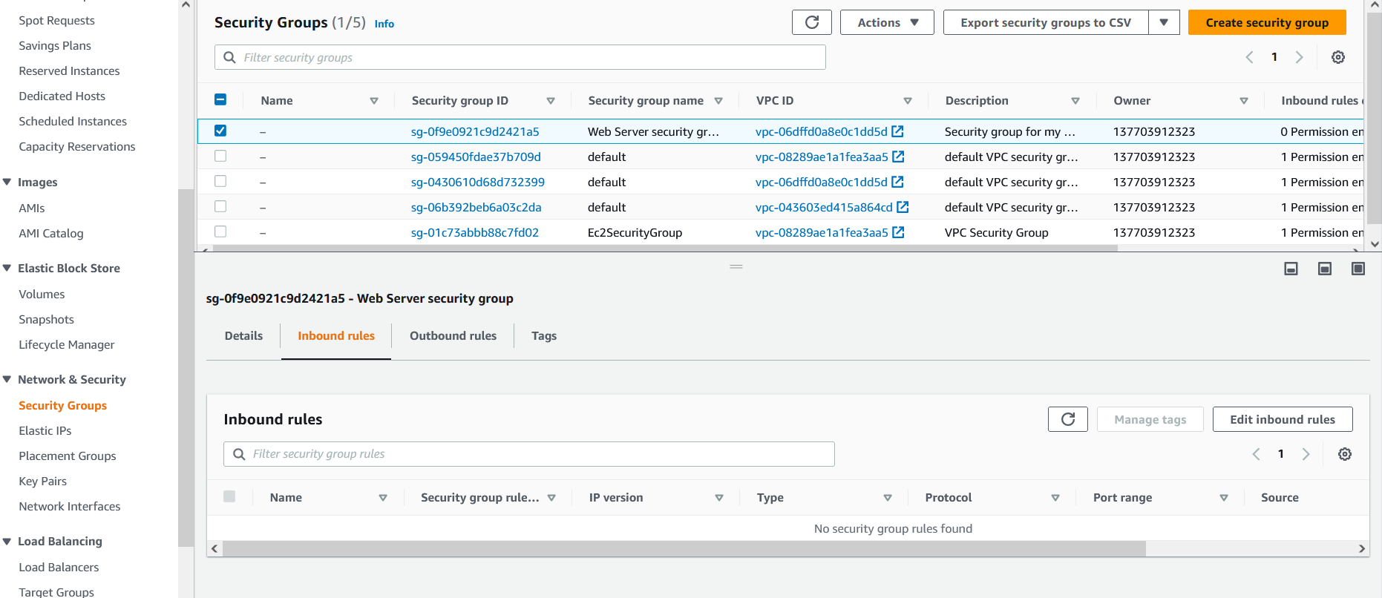
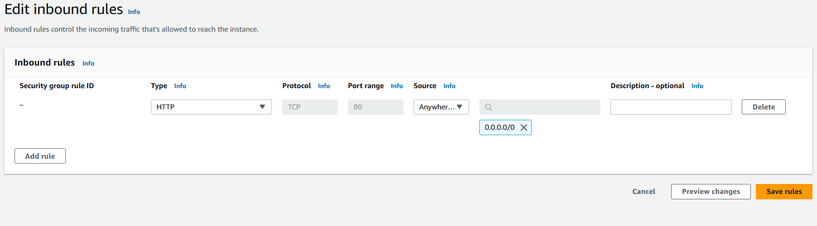
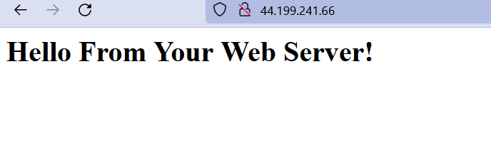
Keep the browser tab open, but return to the EC2 Console tab. In the left navigation pane, choose Security Groups. Select Web Server security group. Choose the Inbound rules tab. The security group currently has no inbound rules. Choose Edit inbound rules, select Add rule and then configure:
Type: HTTP
Source: Anywhere-IPv4
Choose Save rules
Return to the web server tab that you previously opened and
refresh the page. You should see the message Hello From Your Web Server!
Congratulations! We have successfully modified our security group to permit HTTP traffic into our Amazon EC2 Instance.

Slide 17
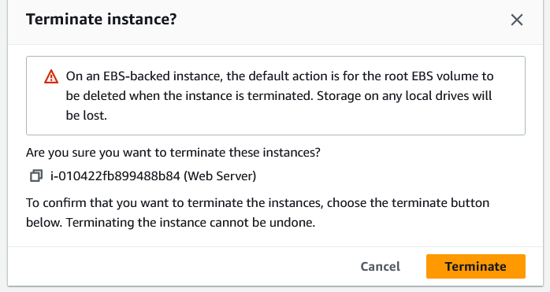
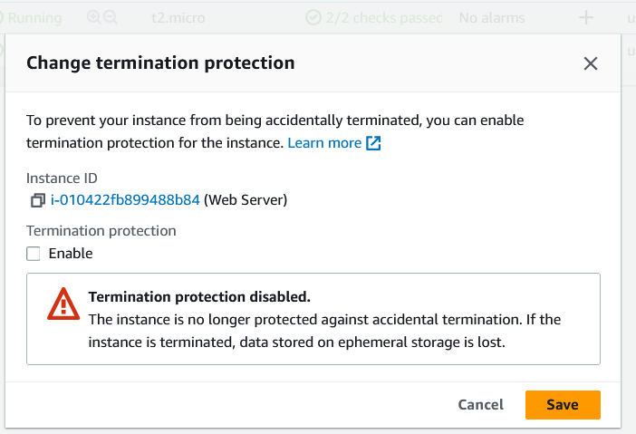
Task 6: Test Termination Protection
You can delete your instance when you no longer need it. This is referred to as terminating your instance. You cannot connect to or restart an instance after it has been terminated. In this task, you will learn how to use termination protection.
In left navigation pane, choose Instances. Select the Web Server instance and in the Instance state menu, select Terminate instance. Then choose Terminate Note that there is a message that says: Failed to terminate the instance i-1234567xxx.
The instance 'i-1234567xxx' may not be terminated. Modify its 'disableApiTermination' instance
attribute and try again. In the Actions menu, select Instance settings Change termination protection. Remove the check next to Enable. Choose Save You can now terminate the instance. Select the Web Server instance again and in the Instance state menu, select Terminate instance. Choose Terminate
Congratulations! You have successfully tested termination protection and terminated
your instance.
End the Lab

Slide 18
LAB 2 - VPC

Slide 19
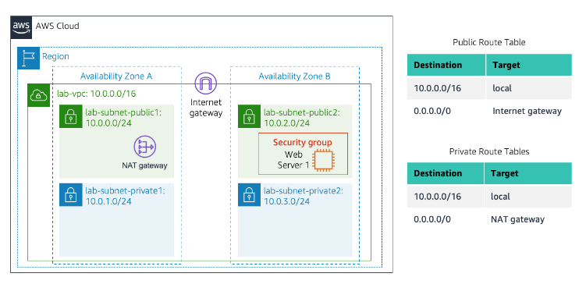
Lab 2: Build your VPC and Launch a Web Server
Amazon Virtual Private Cloud (Amazon VPC) enables you to launch Amazon Web Services (AWS) resources into a virtual network that you defined. This virtual network closely resembles a traditional network that you would operate in your own data center, with the benefits of using the scalable infrastructure of AWS. You can create a VPC that spans multiple Availability Zones.
Scenario

Slide 20
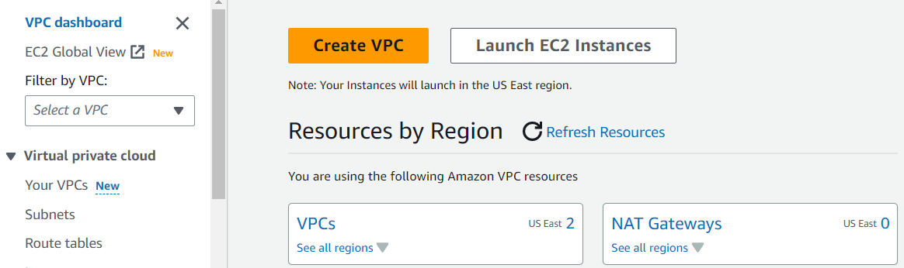
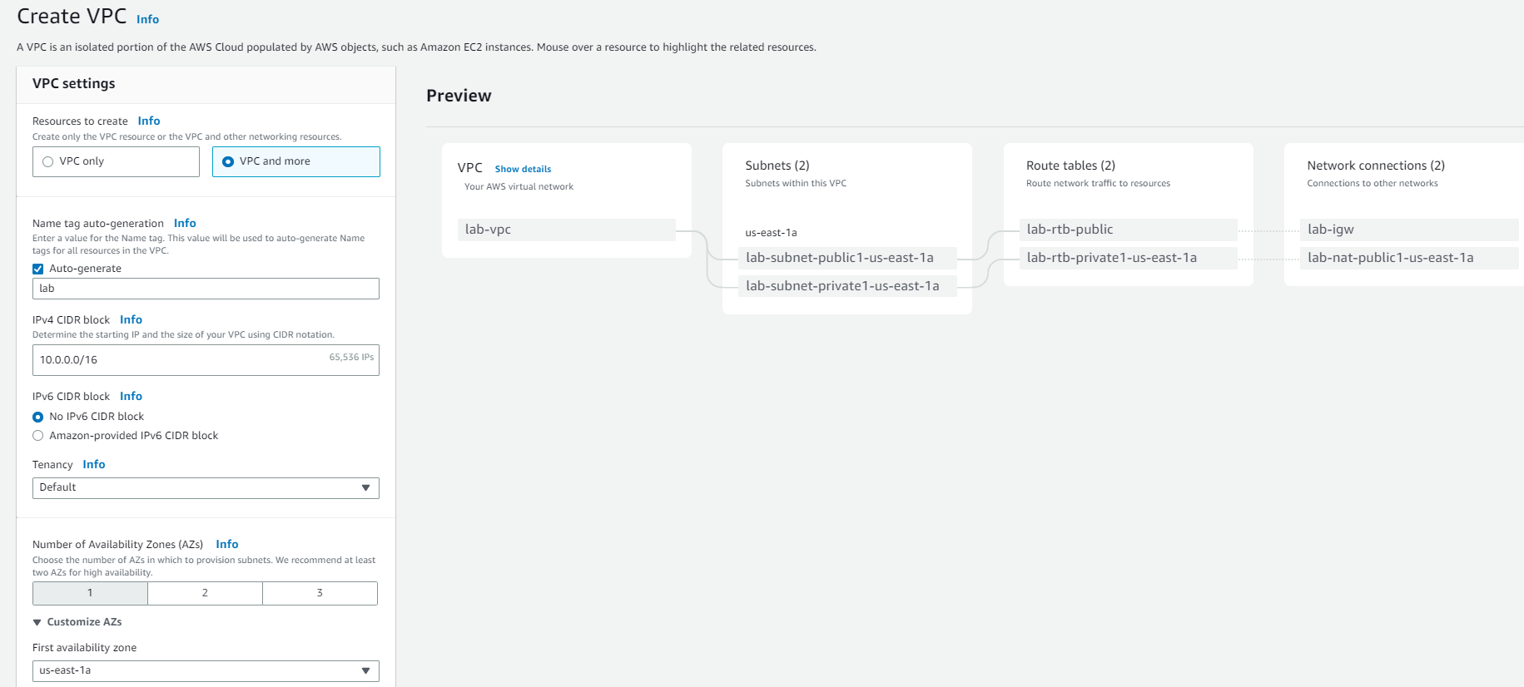
Task 1: Create Your VPC
Begin creating a VPC.
In the top right of the screen, verify that N. Virginia (us-east-1) is the region.
Choose the VPC dashboard link which is also towards the top left of the console.
Next, choose Create VPC. Note: If you do not see a button with that name, choose the Launch VPC Wizard button instead.
Configure the VPC details in the VPC settings panel on the left:
Choose VPC and more.
Under Name tag auto-generation, keep Auto-generate selected, however change the value from project to lab.
Keep the IPv4 CIDR block set to 10.0.0.0/16
For Number of Availability Zones, choose 1.

Slide 21
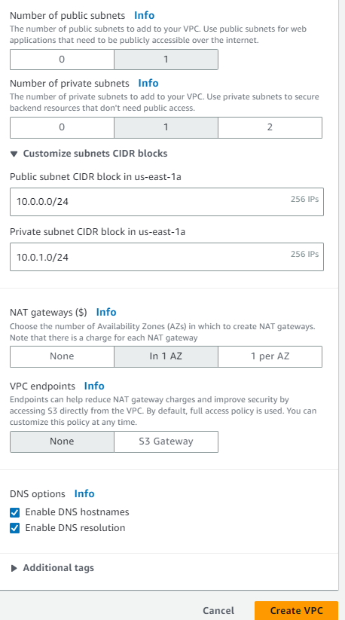
For Number of public subnets, keep the 1 setting.
For Number of private subnets, keep the 1 setting.
Expand the Customize subnets CIDR blocks section
Change Public subnet CIDR block in us-east-1a to 10.0.0.0/24
Change Private subnet CIDR block in us-east-1a to 10.0.1.0/24
Set NAT gateways to In 1 AZ.Set VPC endpoints to None.
Keep both DNS hostnames and DNS resolution enabled. In the Preview panel on the right, confirm the settings you have configured.
VPC: lab-vpc
Subnets:
us-east-1a
Public subnet name: lab-subnet-public1-us-east-1a
Private subnet name: lab-subnet-private1-us-east-1a
Route tableslab-rtb-public lab-rtb-private1-us-east-1a
Network connections lab-igw lab-nat-public1-us-east-1a
At the bottom of the screen, choose Create VPC choose View VPC

Slide 22
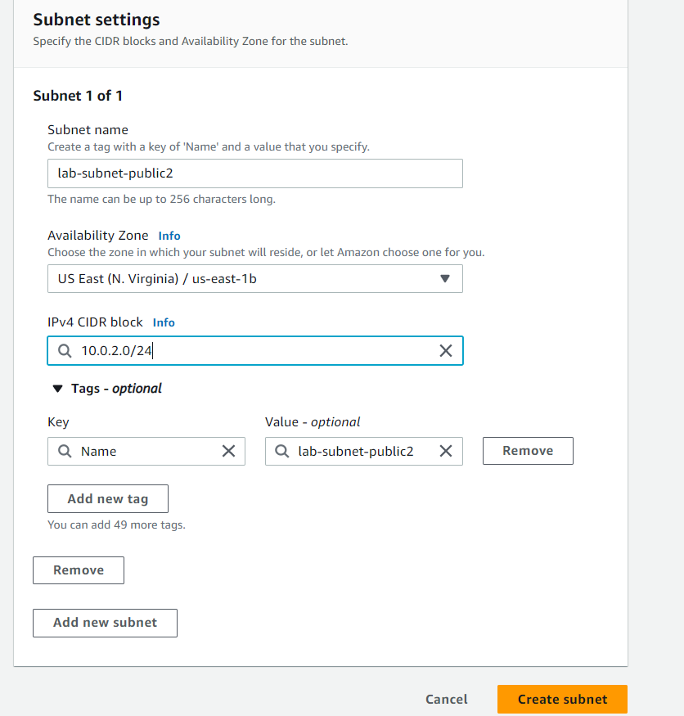
Task 2: Create Additional Subnets
In the left navigation pane, choose Subnets.
First, you will create a second public subnet.
Choose Create subnet then configure:
VPC ID: lab-vpc (select from the menu).
Subnet name: lab-subnet-public2
Availability Zone: Select the second Availability Zone
(for example, us-east-1b)
IPv4 CIDR block: 10.0.2.0/24
The subnet will have all IP addresses starting with
10.0.2.x.
Choose Create subnet

Slide 23
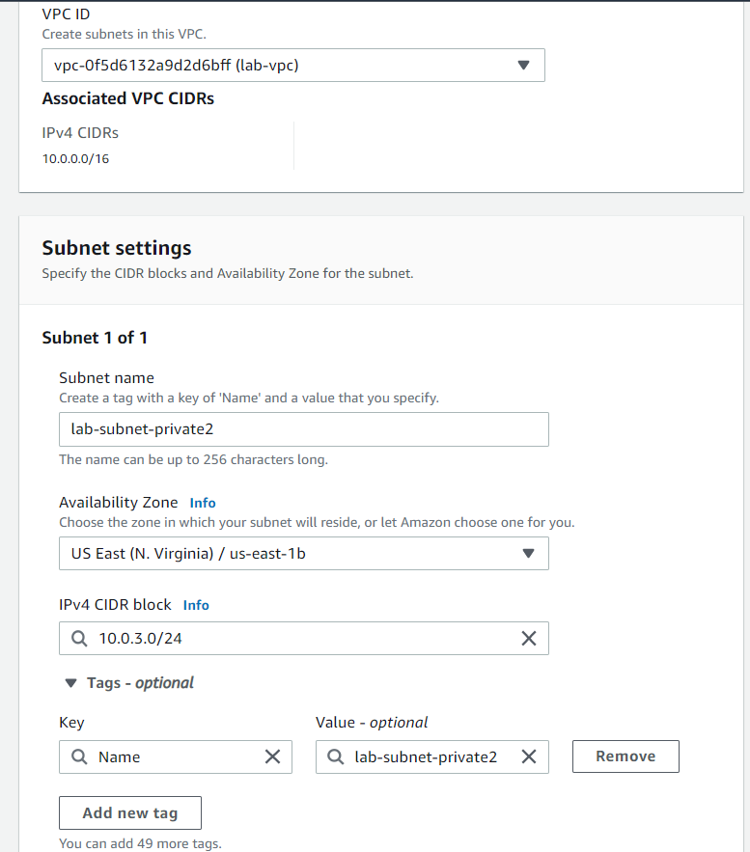
Choose Create subnet then configure:
VPC ID: lab-vpc
Subnet name: lab-subnet-private2
Availability Zone: Select the second Availability Zone
(for example, us-east-1b)
IPv4 CIDR block: 10.0.3.0/24
The subnet will have all IP addresses starting with 10.0.3.x.
Choose Create subnet

Slide 24
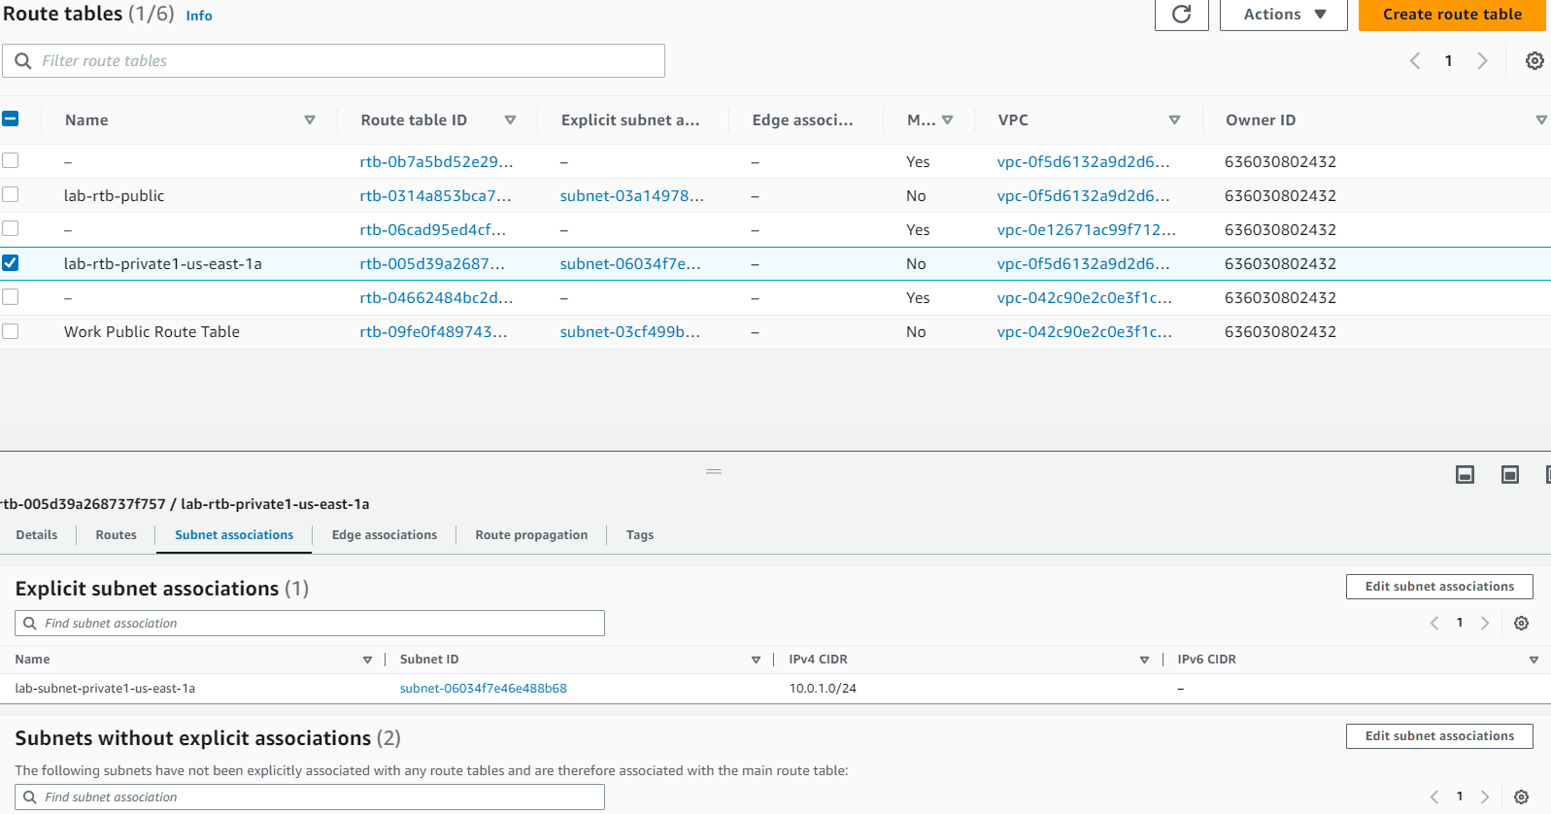
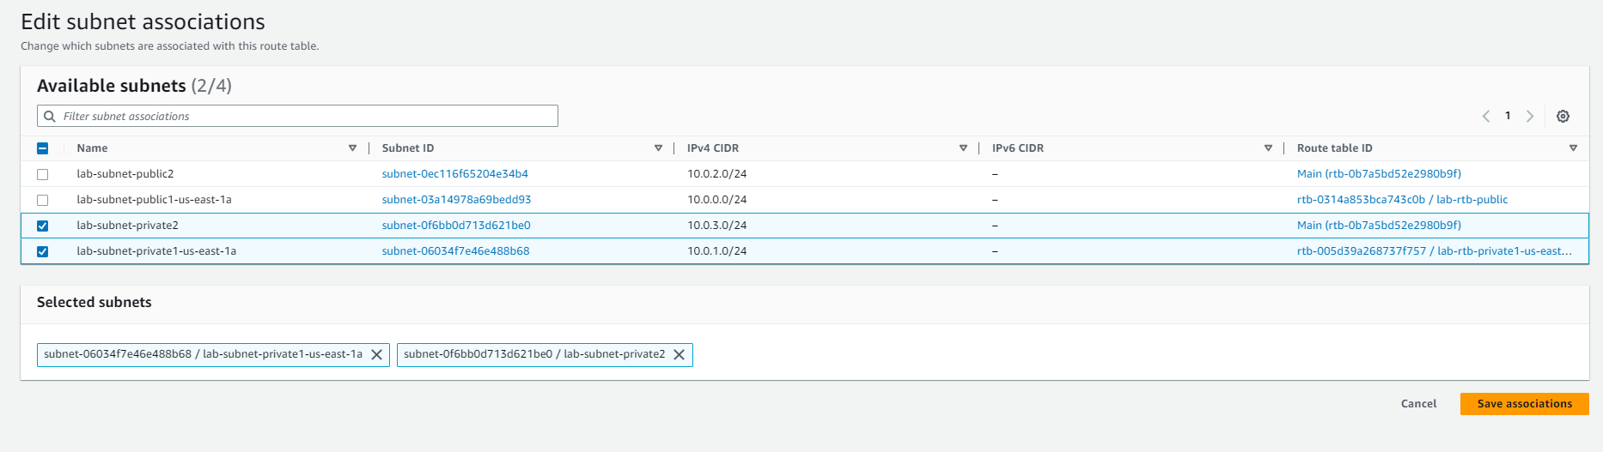
In the left navigation pane, choose Route tables.
Select the lab-rtb-private1-us-east-1a route table.
In the Explicit subnet associations panel,
choose Edit subnet associations
Leave lab-subnet-private1-us-east-1a selected,
but also select lab-subnet-private2.
Choose Save associations

Slide 25
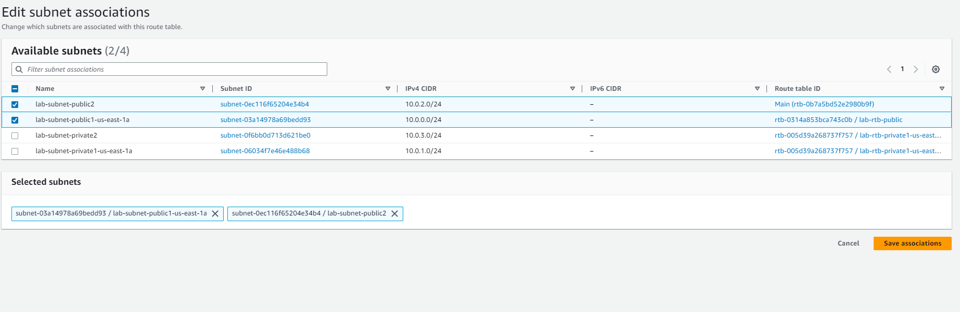
Select the lab-rtb-public route table
Choose the Subnet associations tab. In the Explicit subnet associations area, choose Edit subnet associations Leave lab-subnet-public1-us-east-1a selected, but also select lab-subnet-public2. Choose Save associations

Slide 26
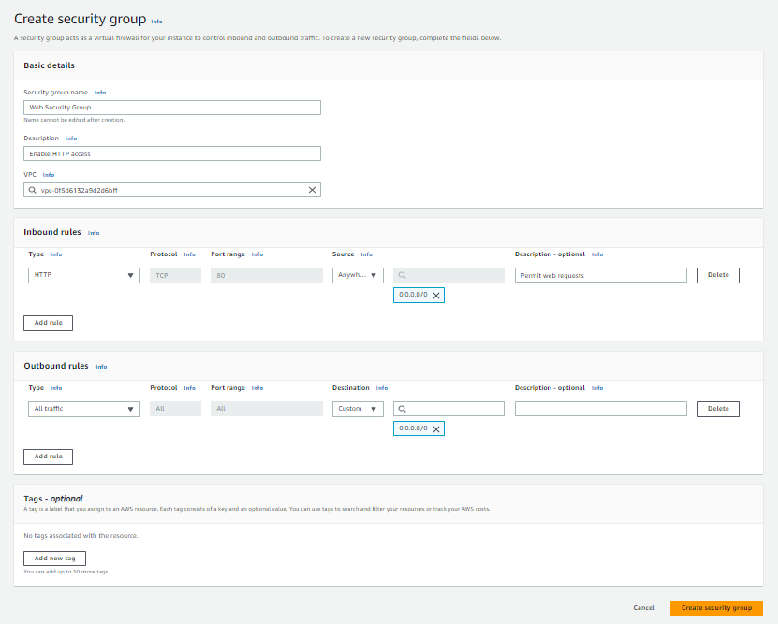
Task 3: Create a VPC Security Group
In the left navigation pane,
choose Security groups.
Choose Create security group and
then configure:
Security group name:
Web Security Group
Description: Enable HTTP access
choose lab-vpc In the Inbound rules pane,
choose Add rule
Type: HTTP
Source: Anywhere-IPv4
Description: Permit web requests
choose Create security group

Slide 27
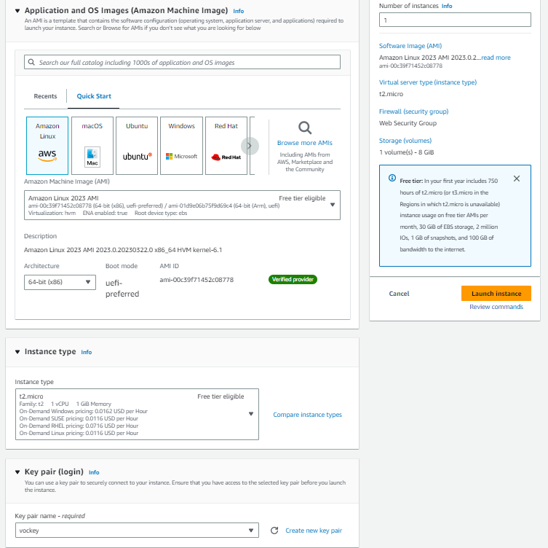
Task 4: Launch a Web Server Instance
.
In the search box to the
right of Services, search for
and choose EC2 to open the
EC2 console.
From the Launch instance
menu choose
Launch instance.
Name the instance:
Give it the name
Web Server 1

Slide 28
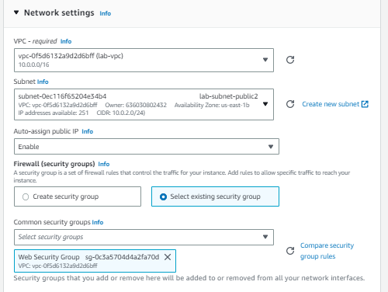
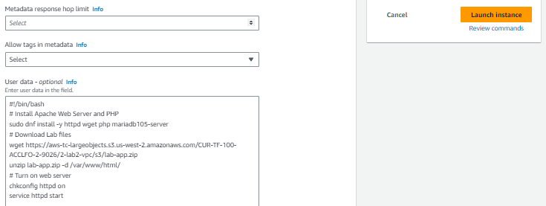
Choose an Instance type: t2.micro
From the Key pair name menu, select vockey.
Configure the Network settings
Next to Network settings, choose Edit, then configure:
Network: lab-vpc
Subnet: lab-subnet-public2
Auto-assign public IP: Enable
Common security groups, select Web Security
Group.
Expand the Advanced details panel.
Launch instance
Wait until Web Server 1 shows 2/2 checks
passed in the Status check column.

Slide 29
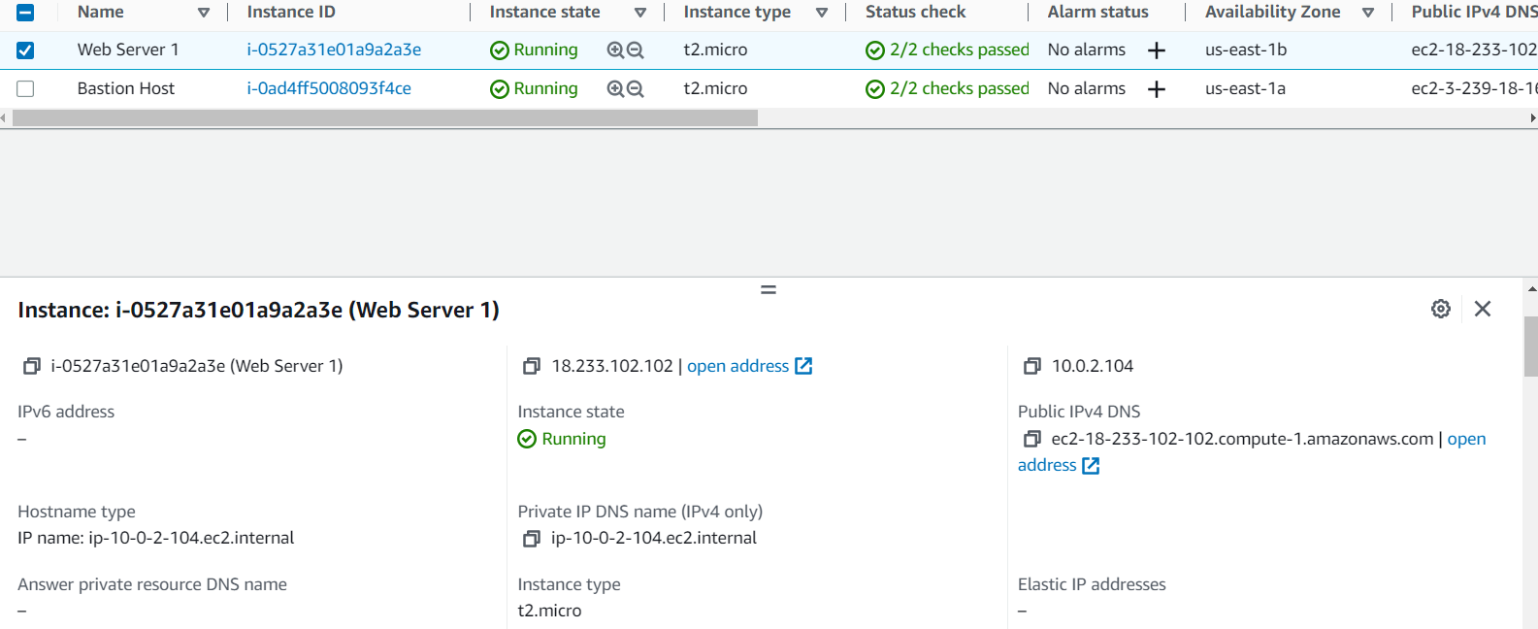
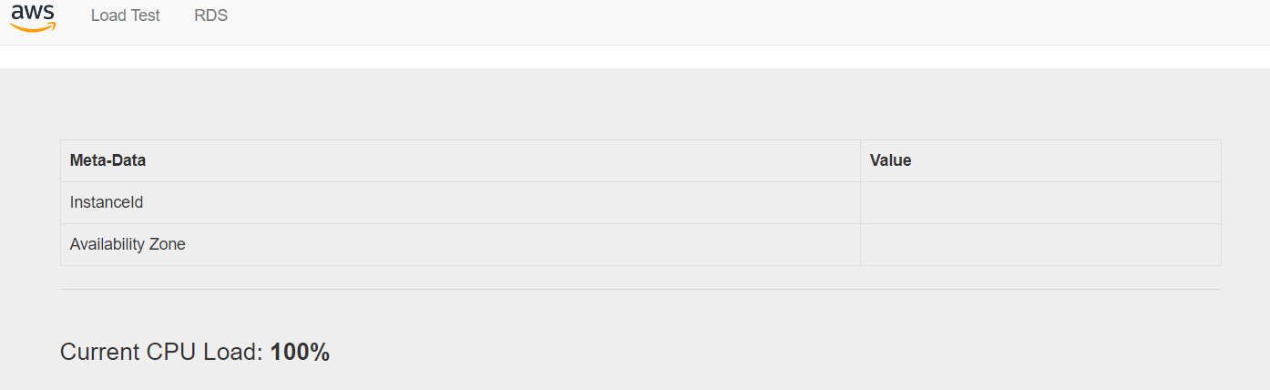
Select Web Server 1.
Copy the Public IPv4 DNS value
shown in the Details tab at the
bottom of the page.
Open a new web browser tab,
paste the Public DNS value and
press Enter.
You should see a web page
displaying the AWS logo and
instance meta-data values.
END the lab

Slide 30
LAB 3 - DB Server

Slide 31
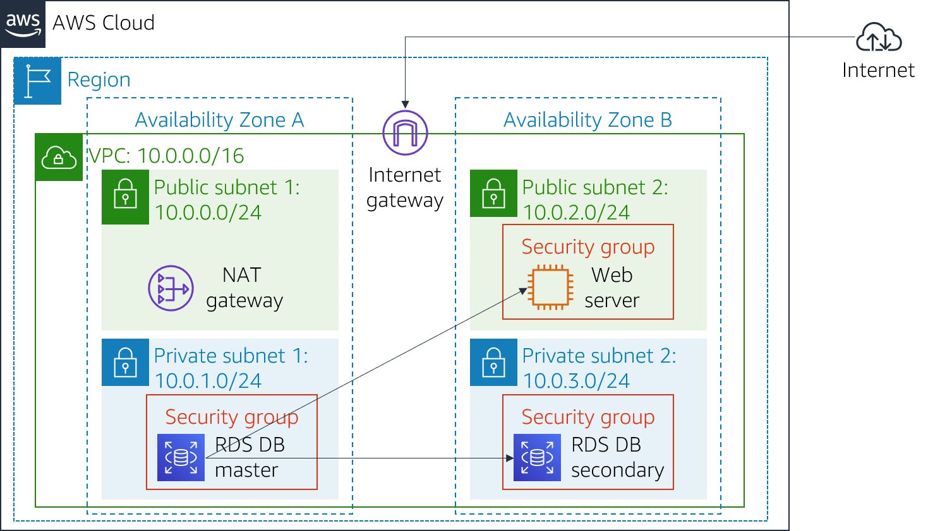
Lab 3: Build Your DB Server and Interact With Your DB Using an App
Amazon Relational Database Service (Amazon RDS) makes it easy to set up, operate, and scale a relational database in the cloud. It provides cost-efficient and resizable capacity while managing time-consuming database administration tasks, which allows you to focus on your applications and business. Amazon RDS provides you with six familiar database engines to choose from: Amazon Aurora, Oracle, Microsoft SQL Server,PostgreSQL, MySQL and MariaDB.

Slide 32
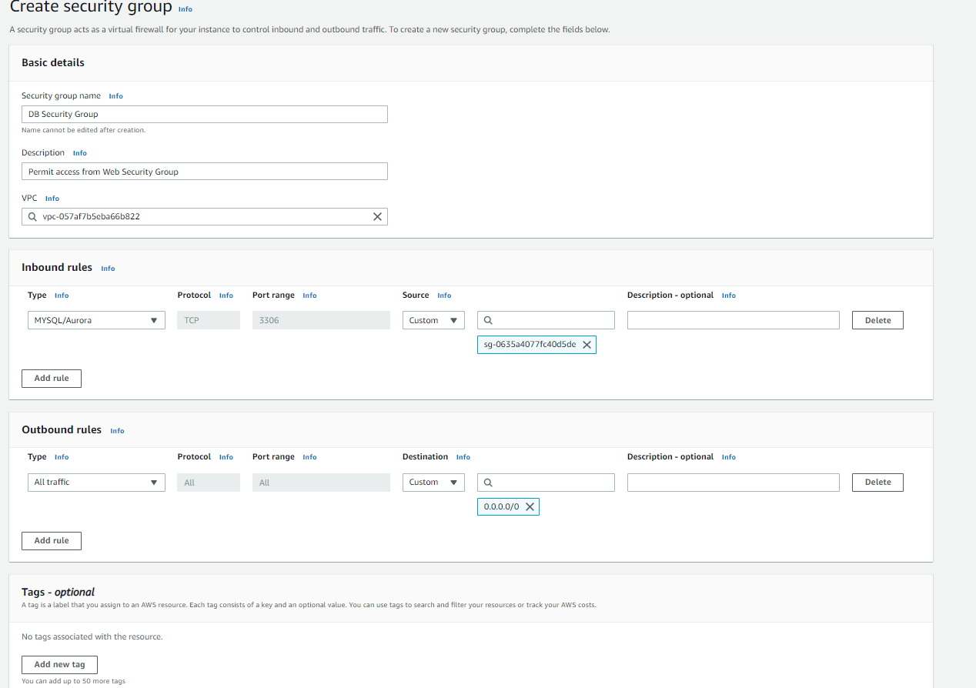
Task 1: Create a Security Group for the RDS DB Instance
Security group name: DB Security Group
Description: Permit access from Web Security Group
VPC: Lab VPC
In the Inbound rules pane
Type: MySQL/Aurora (3306)
CIDR, IP, Security Group or Prefix List: Type sg and then select Web Security Group.

Slide 33
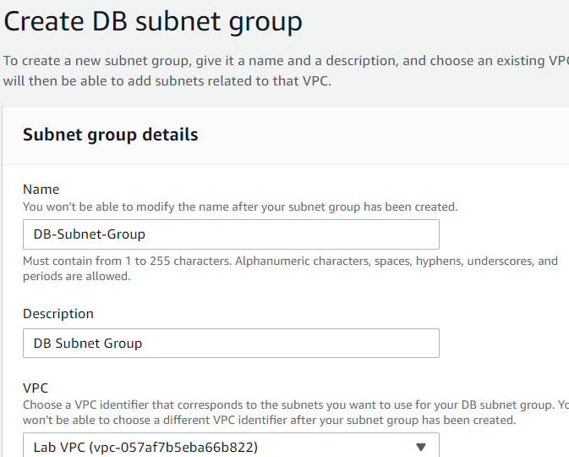
Task 2: Create a DB Subnet Group
Choose RDS
Choose Subnet groups.
Choose Create DB Subnet Group then configure:
Name: DB-Subnet-Group
Description: DB Subnet Group
VPC: Lab VPC

Slide 34
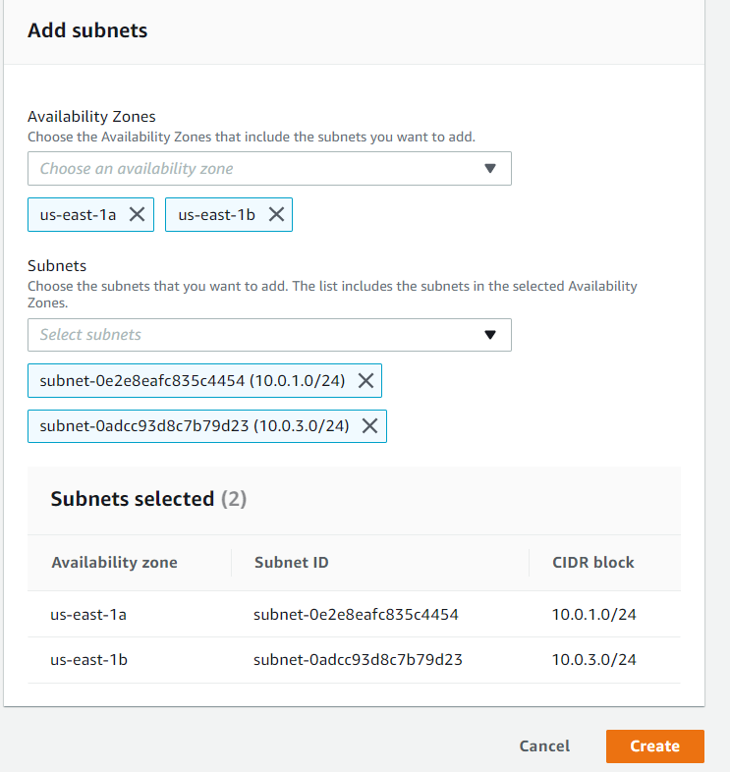
Scroll down to the Add Subnets section.
Expand the list of values under Availability
Zones
and select the first two zones: us-east-1a and
us-east-1b.
Expand the list of values under Subnets and
select the subnets associated with the CIDR
ranges 10.0.1.0/24 and 10.0.3.0/24. These subnets should now be shown in the
Subnets selected table.
Choose Create

Slide 35
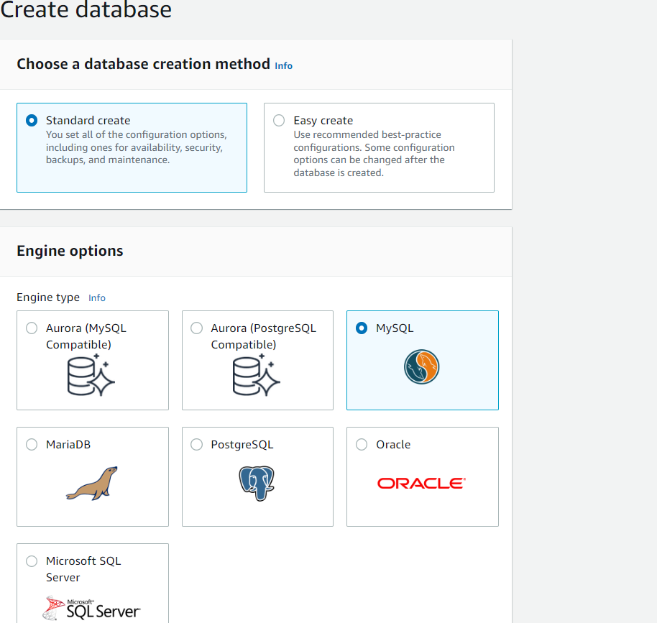
Task 3: Create an Amazon RDS DB Instance
Choose Databases.
Select MySQL.

Slide 36
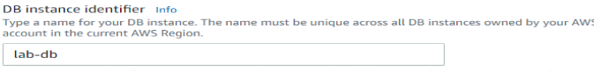

Under Settings, configure:
DB instance identifier: lab-db
Master username: main
Master password: lab-password
Confirm password: lab-password
Under DB instance class, configure:
Select Burstable classes
(includes t classes).
Select db.t3.micro

Slide 37





Slide 38

Uncheck Enable automatic
backups.
Uncheck Enable encryption
Uncheck Enable Enhanced
monitoring.

Slide 39

Task 4: Interact with Your Database
To copy the Web Server IP address, choose on the Details drop down menu above these instructions, and then choose Show.Open a new web browser tab, paste the Web Server IP address and press Enter. The web application will be displayed, showing information about the EC2 instance.Choose the RDS link at the top of the page. You will now configure the application to connect to your database.

Slide 40



Slide 41


End the lab

Slide 42
LAB 4 - IAM

Slide 43

Lab 4: Introduction to AWS IAM
AWS Identity and Access Management (IAM) is a web service that enables Amazon Web Services (AWS) customers to manage users and user permissions in AWS. With IAM, you can centrally manage users, security credentials such as access keys, and permissions that control which AWS resources users can access.
Exploring pre-created IAM Users and Groups
Inspecting IAM policies as applied to the pre-created groups
Following a real-world scenario, adding users to groups with
specific capabilities enabled
Locating and using the IAM sign-in URL
Experimenting with the effects of policies on service access

Slide 44


Task 1: Explore the Users and Groups
In this task, you will explore the Users and Groups that have already been created for you in IAM.
In the AWS Management Console, on the Services menu, select IAM. In the navigation pane on the left, choose Users. The following IAM Users have been created for you:
user-1
user-2
user-3
Choose user-1. This will bring to a summary page for user-1. The Permissions tab will be displayed. Notice that user-1 does not have any permissions. Choose the Groups tab. user-1 also is not a member of any groups. Choose the Security credentials tab. user-1 is assigned a Console password

Slide 45


In the navigation pane on the left, choose User groups. The following groups have already been created for you:
EC2-Admin
EC2-Support
S3-Support
Choose the EC2-Support group. This will bring you to the summary page for the EC2-Support group.
Choose the Permissions tab. This group has a Managed Policy associated with it, called AmazonEC2ReadOnlyAccess. Managed Policies are pre-built policies (built either by AWS or by your administrators) that can be attached to IAM Users and Groups. When the policy is updated, the changes to the policy are immediately apply against all Users and Groups that are attached to the policy.

Slide 46



Choose the plus (+) icon next to the AmazonEC2ReadOnlyAccess policy to view the policy details. Note: A policy defines what actions are allowed or denied for specific AWS resources. This policy is granting permission to List and Describe information about EC2, Elastic Load Balancing, CloudWatch and Auto Scaling. Choose the minus icon (-) to hide the policy details.
In the navigation pane on the left, choose User groups. Choose the S3-Support group and then choose the Permissions tab. The S3-Support group has the AmazonS3ReadOnlyAccess policy attached. Choose the plus (+) icon to view the policy details. This policy grants permissions to Get and List resources in Amazon S3. Choose the minus icon (-) to hide the policy details.
In the navigation pane on the left, choose User groups. Choose the EC2-Admin group and then choose the Permissions tab. This Group is slightly different from the other two. Instead of a Managed
Policy, it has an Inline Policy, which is a policy assigned to just one User
or Group. Inline Policies are typically used to apply permissions for one-off
situations. Choose the plus (+) icon to view the policy details.

Slide 47





Task 2: Add Users to Groups
Add user-1 to the S3-Support Group
In the left navigation pane, choose User groups. Choose the S3-Support group. Choose the Users tab. In the Users tab, choose Add users.
In the Add Users to S3-Support window, configure the following:
Select user-1.
At the bottom of the screen, choose Add Users.
In the Users tab you will see that user-1 has been added to the group.
Add user-2 to the EC2-Support Group
Using similar steps to the ones above, add user-2 to the EC2-Support group. user-2 should now be part of the EC2-Support group.
Add user-3 to the EC2-Admin Group
Using similar steps to the ones above, add user-3 to the EC2-Admin group. user-3 should now be part of the EC2-Admin group.
In the navigation pane on the left, choose User groups. Each Group should now have a 1 in the Users column for the number of Users in each Group. If you do not have a 1 beside each group, revisit the above instructions above to ensure that each user is assigned to a User group, as shown in the table in the Business Scenario section.

Slide 48


Task 3: Sign-In and Test Users
In this task, you will test the permissions of each IAM User.
In the navigation pane on the left, choose Dashboard. An IAM users sign-in link is displayed on the right. It will look similar to: https://123456789012.signin.aws.amazon.com/console This link can be used to sign-in to the AWS Account you are currently using. Copy the Sign-in URL for IAM users in this account to a text editor.
Open a private (Incognito) window.
Mozilla Firefox
Choose the menu bars at the top-right of the screen
Select New private window
Google Chrome
Choose the ellipsis at the top-right of the screen
Select New Incognito Window
Microsoft Edge
Choose the ellipsis at the top-right of the screen
Choose New InPrivate window
Microsoft Internet Explorer
Choose the Tools menu option
Choose InPrivate Browsing
Paste the IAM users sign-in link into the address bar of your private browser session and press Enter. Next, you will sign-in as user-1, who has been hired as your Amazon S3 storage support staff.
Sign-in with:
IAM user name: user-1 & Password: Lab-Password1

Slide 49



In the Services menu, choose S3. Choose the name of the bucket that exists in the account and browse the contents. Since your user is part of the S3-Support Group in IAM, they have permission to view a list of Amazon S3 buckets and the contents. Note: The bucket does not contain any objects.
Now, test whether they have access to Amazon EC2. In the Services menu, choose EC2. In the left navigation pane, choose Instances. You cannot see any instances. Instead, you see a message that states You are not authorized to perform this operation. This is because this user has not been granted any permissions to access Amazon EC2.
You will now sign-in as user-2, who has been hired as your Amazon EC2 support person. Sign user-1 out of the AWS Management Console by completing the following actions:
At the top of the screen, choose user-1
Choose Sign Out

Slide 50

Paste the IAM users sign-in link into your private browser tab's address bar and press Enter. Note: This link should be in your text editor. Sign-in with:
IAM user name: user-2
Password: Lab-Password2
In the Services menu, choose EC2. In the navigation pane on the left, choose Instances. You are now able to see an Amazon EC2 instance because you have Read Only permissions. However, you will not be able to make any changes to Amazon EC2 resources. If you cannot see an Amazon EC2 instance, then your Region may be incorrect. In the top-right of the screen, pull-down the Region menu and select the region that you noted at the start of the lab (for example, N. Virginia).
Select the instance named LabHost.
In the Instance state menu above, select Stop instance. In the Stop Instance window, select Stop. You will receive an error stating You are not authorized to
perform this operation. This demonstrates that the policy only
allows you to view information, without making changes.

Slide 51

Choose the X to close the Failed to stop the instance message. Next, check if user-2 can access Amazon S3.
In the Services, choose S3. You will see the message You don't have permissions to list buckets because user-2 does not have permission to access Amazon S3. You will now sign-in as user-3, who has been hired as your Amazon EC2 administrator.
Sign user-2 out of the AWS Management Console by completing the following actions:
At the top of the screen, choose user-2
Choose Sign Out
Paste the IAM users sign-in link into your private window and press Enter. Paste the sign-in link into the address bar of your private web browser tab again. If it is not in your clipboard, retrieve it from the text editor where you stored it earlier.
Sign-in with:
IAM user name: user-3
Password: Lab-Password3

Slide 52


In the Services menu, choose EC2. In the navigation pane on the left, choose Instances. As an EC2 Administrator, you should now have permissions to Stop the Amazon EC2 instance. Select the instance named LabHost .
If you cannot see an Amazon EC2 instance, then your Region may be incorrect. In the top-right of the screen, pull-down the Region menu and select the region that you noted at the start of the lab (for example, N. Virginia). In the Instance state menu, choose Stop instance. In the Stop instance window, choose Stop. The instance will enter the stopping state and will shutdown.
Close your private browser window.
Congratulations! You have completed the lab.
End Lab

Slide 53
LAB 5: EBS

Slide 54

Task 1: Create a New EBS Volume
In the AWS Management Console, on the Services menu, click EC2.
In the left navigation pane, choose Instances.
An Amazon EC2 instance named Lab has already been launched for your lab.

Slide 55
In the left navigation pane, choose Volumes. You will see an existing volume that is being used by the Amazon EC2 instance. This volume has a size of 8 GiB, which makes it easy to distinguish from the volume you will create next, which will be 1 GiB in size.
Choose Create volume then configure:
Volume Type: General Purpose SSD (gp2)
Size (GiB): 1. NOTE: You may be restricted from creating large volumes.
Availability Zone: Select the same availability zone as your EC2 instance.
Choose Add Tag
In the Tag Editor, enter:
Key: Name
Value: My Volume
Choose Create Volume Your new volume will appear in the list, and will move from the Creating state to the Available state. You may need to choose refresh to see your new volume.

Slide 56


Slide 57


Slide 58

Task 2: Attach the Volume to an Instance
Select My Volume.
In the Actions menu, choose Attach volume.

Slide 59
Task 3: Connect to Your Amazon EC2 Instance
Windows Users: Using SSH to Connect
Choose the Details drop down menu above these instructions you are currently reading, and then choose Show. A Credentials window will open.
Choose the Download PPK button and save the labsuser.ppk file. Typically your browser will save it to the Downloads directory.
Then exit the Details panel by choosing the X.
Download needed software Putty
You will use PuTTY to SSH to Amazon EC2 instances.
Open putty.exe

Slide 60


Slide 61

Configure PuTTY to not timeout:
Choose Connection
Set Seconds between keepalives to 30
This allows you to keep the PuTTY session open for a longer period of time.

Slide 62
Configure your PuTTY session:
Choose Session
Host Name (or IP address): Paste the Public DNS or IPv4 address of the Lab instance that you noted earlier.
Back in PuTTY, in the Connection list, expand SSH
Choose Auth and expand Credentials
Under Private key file for authentication: Choose Browse
Browse to the labsuser.ppk file that you downloaded, select it, and choose Open
Choose Open again
To trust and connect to the host, choose Accept.
When prompted login as, enter: ec2-user This will connect you to the EC2 instance.

Slide 63


Slide 64


Slide 65


Slide 66

Task 4: Create and Configure Your File System
In this task, you will add the new volume to a Linux instance as an ext3 file system under the /mnt/data-store mount point.
View the storage available on your instance:
df -h

Slide 67

Create an ext3 file system on the new volume:
sudo mkfs -t ext3 /dev/sdf

Slide 68
Create a directory for mounting the new storage volume:
sudo mkdir /mnt/data-store
Mount the new volume:
sudo mount /dev/sdf /mnt/data-store
To configure the Linux instance to mount this volume whenever the instance is started, you will need to add a line to /etc/fstab.
echo "/dev/sdf /mnt/data-store ext3 defaults,noatime 1 2" | sudo tee -a /etc/fstab
View the configuration file to see the setting on the last line:
cat /etc/fstab

Slide 69


Slide 70

View the available storage again:
df -h

Slide 71

On your mounted volume, create a file and add some text to it.
sudo sh -c "echo some text has been written > /mnt/data-store/file.txt"
Verify that the text has been written to your volume.
cat /mnt/data-store/file.txt

Slide 72
Task 5: Create an Amazon EBS Snapshot
In the AWS Management Console, choose Volumes and select My Volume.
In the Actions menu, select Create snapshot.
Choose Add tag then configure:
Key: Name
Value: My Snapshot
Choose Create snapshot
In the left navigation pane, choose Snapshots.

Slide 73



Slide 74

In your remote SSH session, delete the file that you created on your volume.
sudo rm /mnt/data-store/file.txt
Verify that the file has been deleted.
ls /mnt/data-store/
Your file has been deleted.

Slide 75
Task 6: Restore the Amazon EBS Snapshot
Create a Volume Using Your Snapshot
In the AWS Management Console, select My Snapshot.
In the Actions menu, select Create volume from snapshot.
For Availability Zone Select the same availability zone that you used earlier.
Choose Add tag then configure:
Key: Name
Value: Restored Volume
Choose Create volume

Slide 76


Slide 77
Attach the Restored Volume to Your EC2 Instance
In the left navigation pane, choose Volumes.
Select Restored Volume.
In the Actions menu, select Attach volume.
Choose the Instance field, then select the (Lab) instance that appears. Note that the Device field is set to /dev/sdg. You will use this device identifier in a later task.
Choose Attach volume The volume state is now in-use.

Slide 78


Slide 79

Mount the Restored Volume
Create a directory for mounting the new storage volume:
sudo mkdir /mnt/data-store2
Mount the new volume:
sudo mount /dev/sdg /mnt/data-store2
Verify that volume you mounted has the file that you created earlier.
ls /mnt/data-store2/
You should see file.txt.

Slide 80
LAB 6: Scale and Load Balance Your Architecture

Slide 81
Task 1: Create an AMI for Auto Scaling
In the AWS Management Console, on the Services menu, click EC2.
In the left navigation pane, click Instances. First, you will confirm that the instance is running.
Wait until the Status Checks for Web Server 1 displays 2/2 checks passed. Click refresh to update. You will now create an AMI based upon this instance.
Select Web Server 1.
In the Actions menu, click Image and templates > Create image, then configure:
Image name: WebServerAMI
Image description: Lab AMI for Web Server
Click Create image
A confirmation banner displays the AMI ID for your new AMI.

Slide 82


Slide 83


Slide 84

Task 2: Create a Load Balancer
In the left navigation pane, choose Target Groups.
Choose Create target group
Choose a target type: Instances
Target group name, enter: LabGroup
Select Lab VPC from the VPC drop-down menu.

Slide 85


Slide 86
Choose Next. The Register targets screen appears.
Review the settings and choose Create target group
In the left navigation pane, click Load Balancers.
At the top of the screen, choose Create Load Balancer.
Under Application Load Balancer, choose Create
Under Load balancer name, enter: LabELB
Scroll down to the Network mapping section, then:
For VPC, select: Lab VPC
Choose the first displayed Availability Zone, then select Public Subnet 1 from the Subnet drop down menu that displays beneath it.
Choose the second displayed Availability Zone, then select Public Subnet 2 from the Subnet drop down menu that displays beneath it.

Slide 87


Slide 88


Slide 89
In the Security groups section:
Choose the Security groups drop down menu and select Web Security Group
Below the drop down menu, choose the X next to the default security group to remove it. The Web Security Group security group should now be the only one that appears.
For the Listener HTTP:80 row, set the Default action to forward to LabGroup.
Scroll to the bottom and choose Create load balancer
The load balancer is successfully created.
Choose View load balancer

Slide 90



Slide 91
Task 3: Create a Launch Configuration and an Auto Scaling Group
In the left navigation pane, click Launch Configurations.
Click Create launch configuration
Configure these settings:
Launch configuration name: LabConfig
Amazon Machine Image (AMI) Choose Web Server AMI
Instance type:
Choose Choose instance type
Select t3.micro
Choose Choose
Additional configuration
Monitoring: Select Enable EC2 instance detailed monitoring within CloudWatch
Under Security groups, you will configure the launch configuration to use the Web Security Group that has already been created for you.
Choose Select an existing security group
Select Web Security Group
Under Key pair configure:
Key pair options: Choose an existing key pair
Existing key pair: vockey
Select I acknowledge...
Click Create launch configuration

Slide 92



Slide 93
Select the checkbox for the LabConfig Launch Configuration.
From the Actions menu, choose Create Auto Scaling group
Enter Auto Scaling group name:
Name: Lab Auto Scaling Group
Choose Next
On the Network page configure
Network: Lab VPC You can ignore the message regarding "No public IP address"
Subnet: Select Private Subnet 1 (10.0.1.0/24) and Private Subnet 2 (10.0.3.0/24)
This will launch EC2 instances in private subnets across both Availability Zones.
Choose Next
In the Load balancing - optional pane, choose Attach to an existing load balancer
In the Attach to an existing load balancer pane, use the dropdown list to select LabGroup.
In the Additional settings - optional pane, select Enable group metrics collection within CloudWatch This will capture metrics at 1-minute intervals, which allows Auto Scaling to react quickly to changing usage patterns.
Choose Next
Under Group size, configure:
Desired capacity: 2
Minimum capacity: 2
Maximum capacity: 6
This will allow Auto Scaling to automatically add/remove instances, always keeping between 2 and 6 instances running.
Under Scaling policies, choose Target tracking scaling policy and configure:
Lab policy name: LabScalingPolicy
Metric type: Average CPU Utilization
Target value: 60
This tells Auto Scaling to maintain an average CPU utilization across all instances at 60%. Auto Scaling will automatically add or remove capacity as required to keep the metric at, or close to, the specified target value. It adjusts to fluctuations in the metric due to a fluctuating load pattern.
Choose Next Auto Scaling can send a notification when a scaling event takes place. You will use the default settings.
Choose Next Tags applied to the Auto Scaling group will be automatically propagated to the instances that are launched.
Choose Add tag and Configure the following:
Key: Name
Value: Lab Instance
Click Next
Review the details of your Auto Scaling group, then click Create Auto Scaling group. If you encounter an error Failed to create Auto Scaling group, then click Retry Failed Tasks. Your Auto Scaling group will initially show an instance count of zero, but new instances will be launched to reach the Desired count of 2 instances.

Slide 94


Slide 95

End The Lab

